Slide 1

SMART INDIA HACKATHON 2026
Problem Statement ID –
Problem Statement Title-
Theme-
PS Category- Software/Hardware
Team ID-
Team Name: NOVA

Slide 2

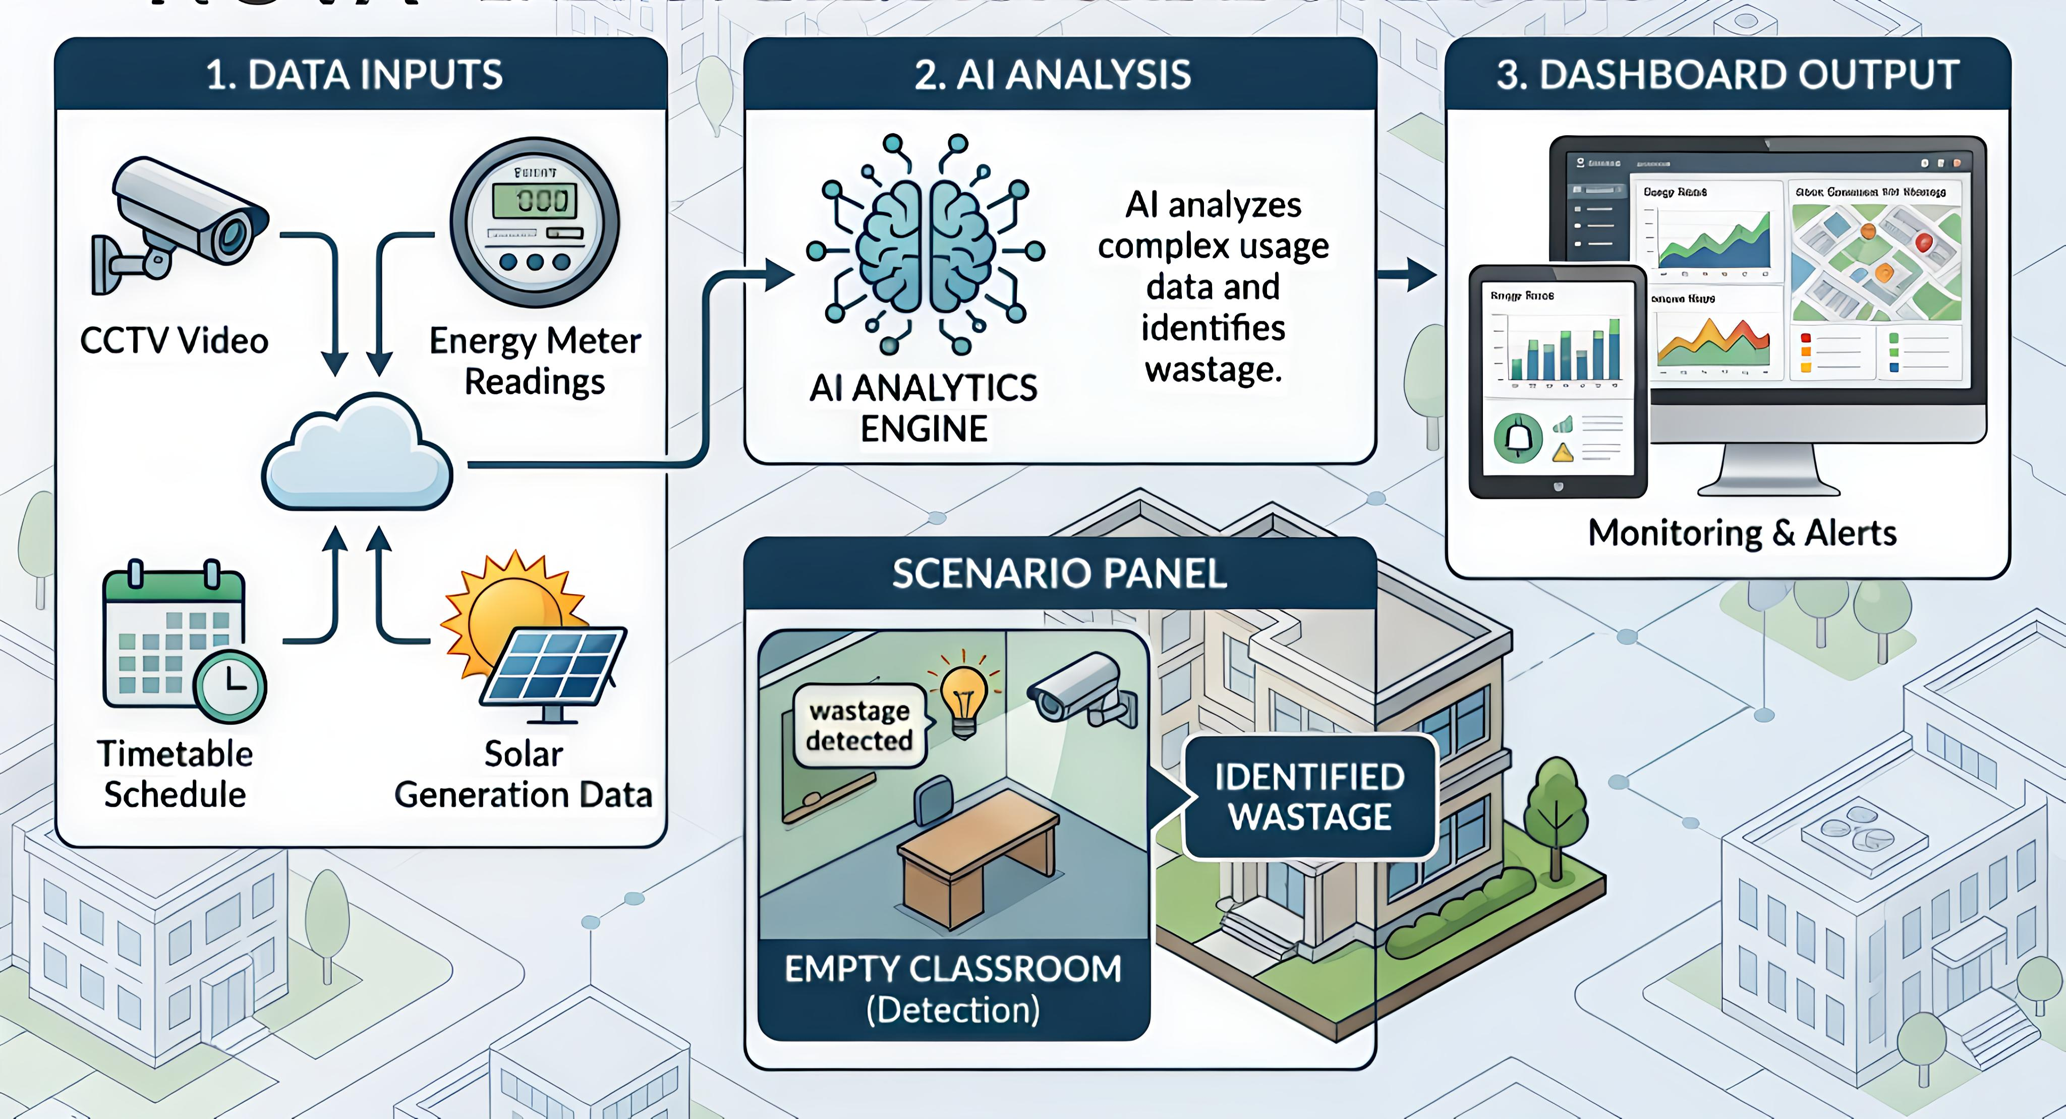
ENERGY EYE
AI-Powered Smart Campus Energy Management
Detect energy wastage in empty classrooms.
Use CCTV + Energy Meter + Timetable + Solar Data.
AI analyzes usage and identifies possible wastage.
Dashboard provides monitoring and alerts.

Slide 3
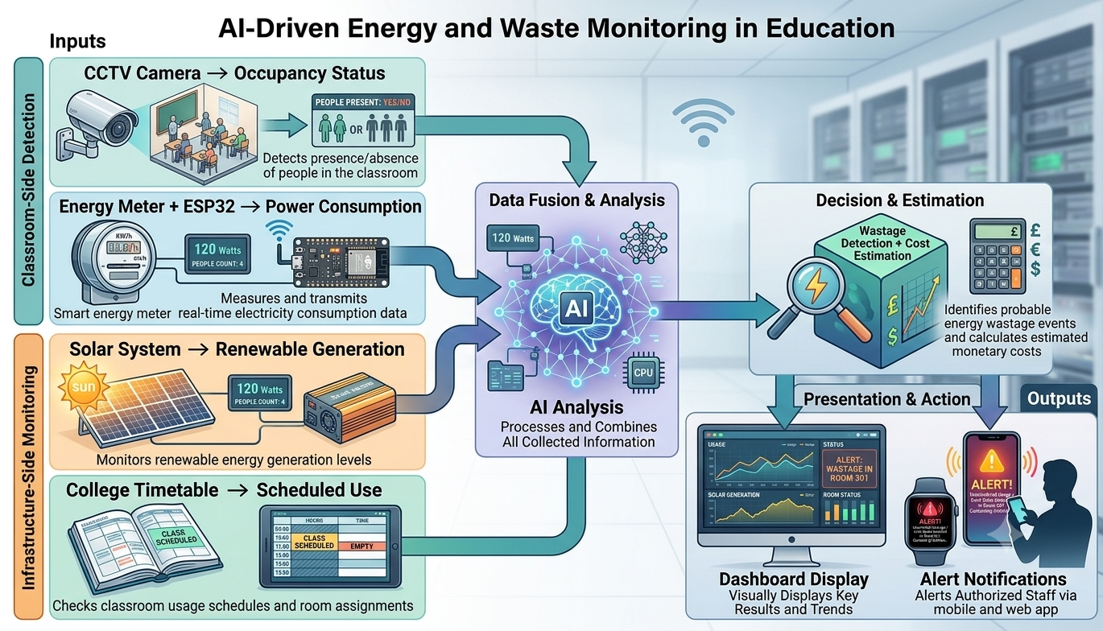
TECHNICAL APPROACH
CCTV Camera → Detects whether people are present in the classroom ↓ Energy Meter + ESP32 → Measures electricity consumption ↓ Solar System → Monitors renewable energy generation ↓ College Timetable → Checks whether the classroom is scheduled for use ↓ AI Analysis → Combines all the collected information ↓ Wastage Detection + Cost Estimation → Identifies possible wastage and calculates the estimated cost ↓ Dashboard + Notification → Displays the results and alerts authorized staff

Slide 4
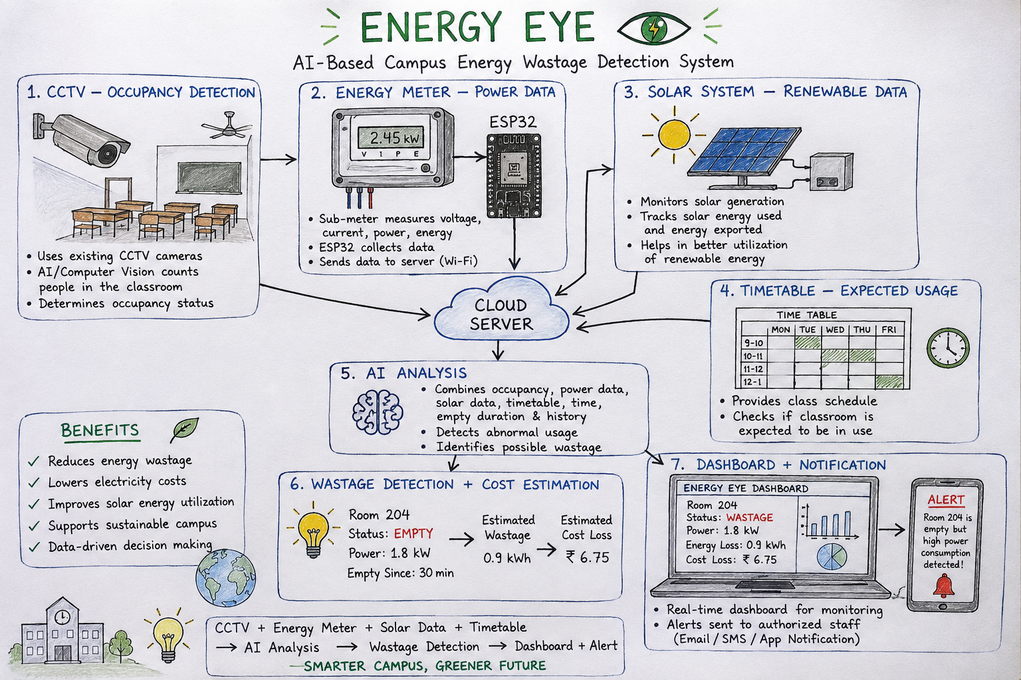
FEASIBILITY AND VIABILITY
Uses existing CCTV infrastructure.
Low-cost ESP32 + energy monitoring.
Prototype possible with one classroom.
Can reduce electricity costs.
Easily scalable to the entire campus.

Slide 5
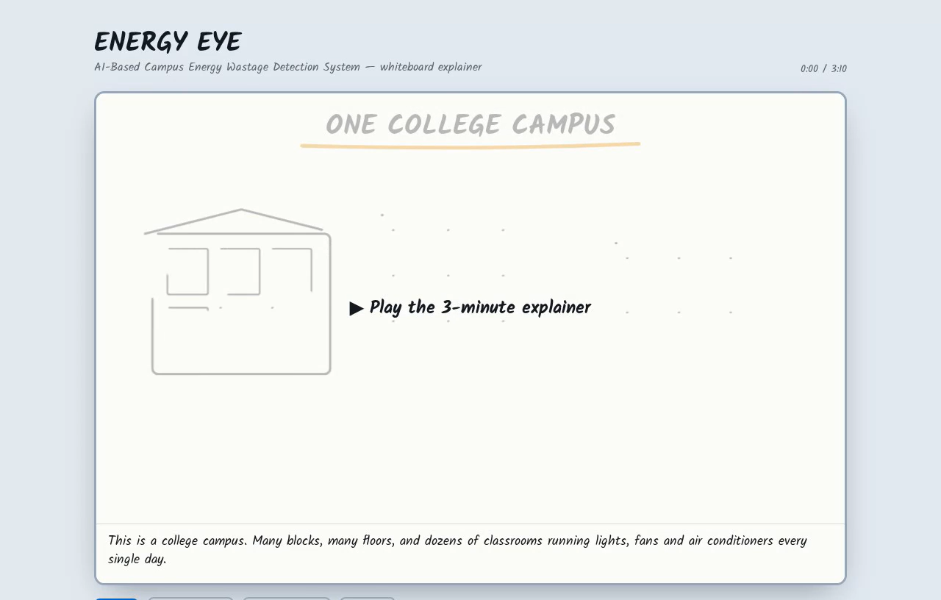

Slide 6
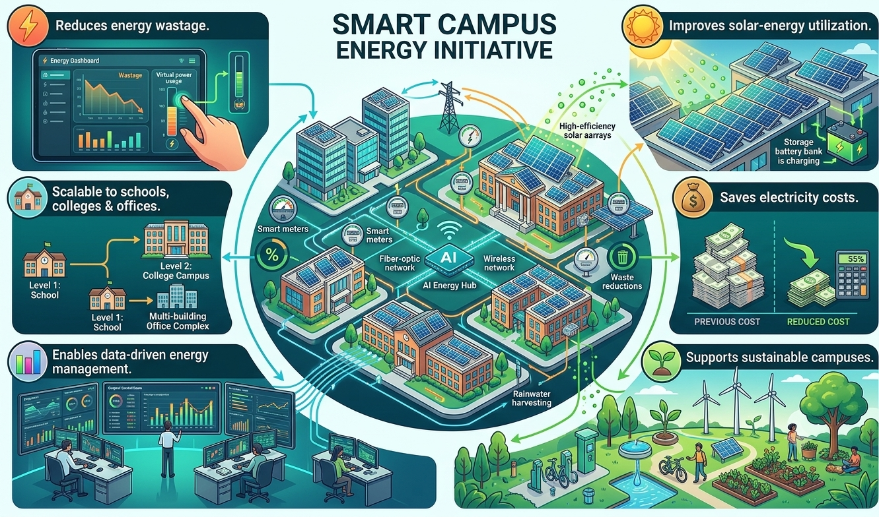
IMPACT AND BENEFITS
⚡ Reduces energy wastage.
☀️ Improves solar-energy utilization.
💰 Saves electricity costs.
🌱 Supports sustainable campuses.
📊 Enables data-driven energy management.
🏫 Scalable to schools, colleges & offices.

Slide 7
RESEARCH AND REFERENCES

